Slide 1

REVIEW OF RESEARCH PAPER
Fiber Reinforced Concrete Properties (1971)
- By Surendra P. Shah and B. Vijaya Rangan
NAME: M HEMA VARSHNI
YEAR & DEPT: 3rd Year Civil Engineering|
GUIDE NAME: Dr.Keerthana Kirupakaran

Slide 2
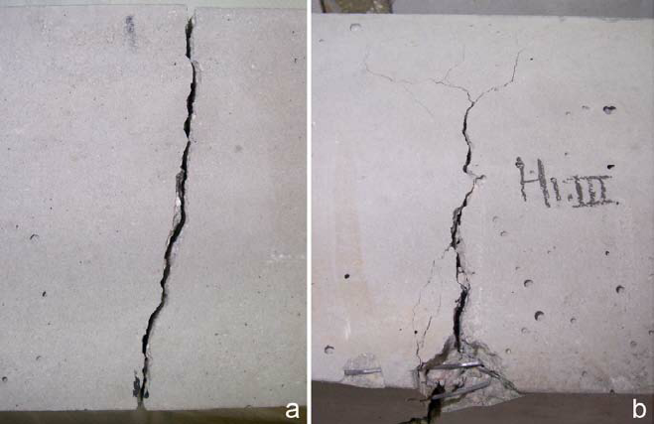
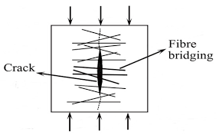
WHY FIBER REINFORCED CONCRETE?
Problem in plain concrete:
  brittle behavior
  low tensile strength
  sudden cracking
  poor toughness
Once cracks form:
  crack propagation becomes rapid
  failure occurs suddenly
Need for Fibers:
  Steel fibers were introduced to:
  improve crack resistance
  improve toughness
  delay crack propagation
  enhance ductility
Fig1. (a) Cracks obtained for plain concrete, (b) concrete with 1.5% fibers.
Fig2. Bridging mechanism of fibre reinforcements.

Slide 3

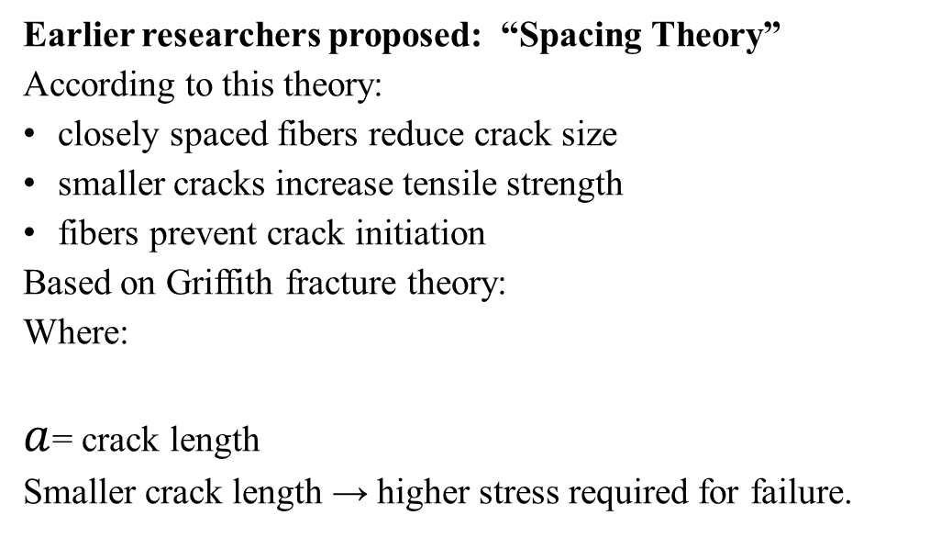
EARLIER UNDERSTANDING
Problem in Existing Understanding:
Earlier studies:
did not clearly separate spacing effect
changed several parameters simultaneously
lacked understanding of post-cracking behavior
Earlier researchers proposed: “Spacing Theory”
According to this theory:
closely spaced fibers reduce crack size
smaller cracks increase tensile strength
fibers prevent crack initiation
Based on Griffith fracture theory:
Where:
$a$= crack length
Smaller crack length → higher stress required for failure.

Slide 4
OBJECTIVE OF THE PAPER
Objectives of the Study
The authors aimed to investigate:
      tensile behavior of SFRC
      flexural behavior
      compressive behavior
      effect of fiber spacing
      effect of orientation
      effect of aspect ratio

Slide 5
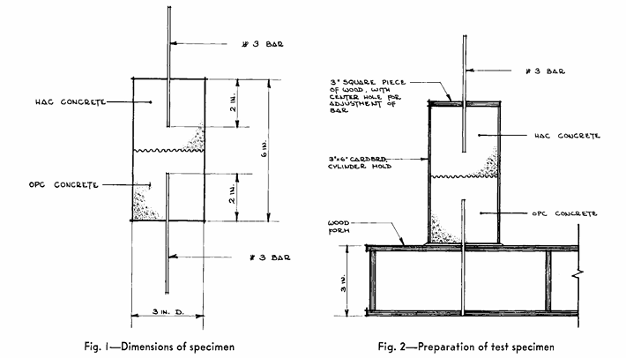
EXPERIMENTAL INVESTIGATION
The authors performed:
1. Flexural Tests
  Measured:
  load-deflection response
  toughness
  crack behavior
2. Tensile Tests
  Measured:
  first crack strength
  post-cracking resistance
3. Compression Tests
  Measured:
  stress-strain response
  ductility
Variables Studied:
  fiber volume fraction
  fiber orientation
  fiber spacing
  aspect ratio
Fig 3. Dimension of the specimen
Fig 4. Prearation of the test specimen

Slide 6
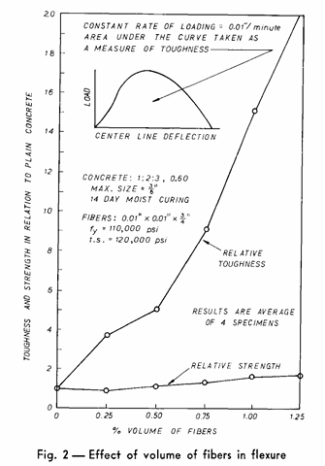
FLEXURAL TEST RESULTS
Experimental Observation:
Addition of fibers caused:
  only moderate increase in strength
  very large increase in toughness
Important Result:
The area under the load-deflection curve increased significantly.
This indicates:
  higher energy absorption capacity
  improved post-cracking resistance
Interpretation:
Fibers:
  bridge cracks after formation
  transfer tensile stress across cracks
  delay crack widening
Important Insight:
Fibers mainly improve:
post-cracking behavior rather than first-crack strength.
Fig 5. Effect of volume of fibres in flexure

Slide 7
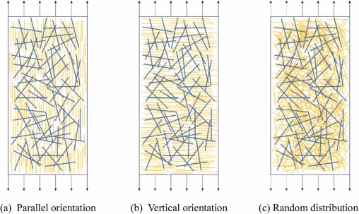
FIBER ORIENTATION STUDY
Three fiber orientations were studied:
Parallel
Random
perpendicular
Significance:
This explains why:
random fibers are less efficient than aligned reinforcement.
Results:
Orientation | Performance
Parallel | Highest strength and toughness
Random | Moderate performance
Perpendicular | Lowest effectiveness
Interpretation:
Fibers are most effective when aligned with:
principal tensile stress direction
crack propagation path
Fig 6. Orientation of fibres

Slide 8

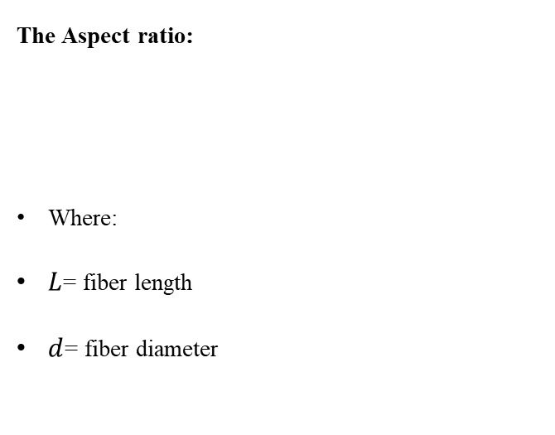
INFLUENCE OF FIBER ASPECT RATIO
The Aspect ratio:
Where:
$L$= fiber length
$d$= fiber diameter
Physical Mechanism:
Long fibers:
require greater pullout energy
provide stronger bridging action
improve stress transfer
Important Insight:
Post-cracking resistance depends strongly on:
fiber pullout mechanism.
Experimental Observation:
Higher aspect ratio fibers showed:
better bond
improved crack bridging
greater toughness

Slide 9
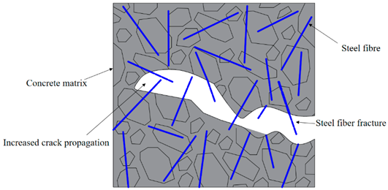
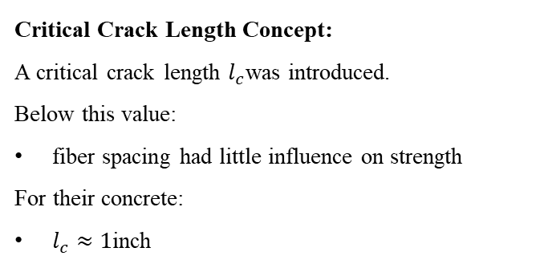
CRACK PROPAGATION MECHANISM & COMPRESSION BEHAVIOR
Compression Behavior of SFRC:
Experimental Observation
  Steel fibers caused:
    small increase in compressive strength
    significant increase in ductility
  SFRC showed:
    smoother post-peak response
    delayed brittle crushing
Physical Mechanism:
Fibers:
restrain internal crack growth
bridge microcracks
dissipate energy during crack propagation
Fibers improve post-cracking behavior and failure mechanism more than peak strength.
Major Discovery of the Paper:
The authors proved that:
fibers donot significantly prevent crack initiation
fibers mainly resist crack propagation
Critical Crack Length Concept:
A critical crack length $l_{c}$was introduced.
Below this value:
fiber spacing had little influence on strength
For their concrete:
$l_{c}≈1$inch
Interpretation:
Concrete becomes:
relatively notch-insensitive below critical crack length.
Fig 7. Mechanism of crack propagation and fiber fracture in SFRC

Slide 10
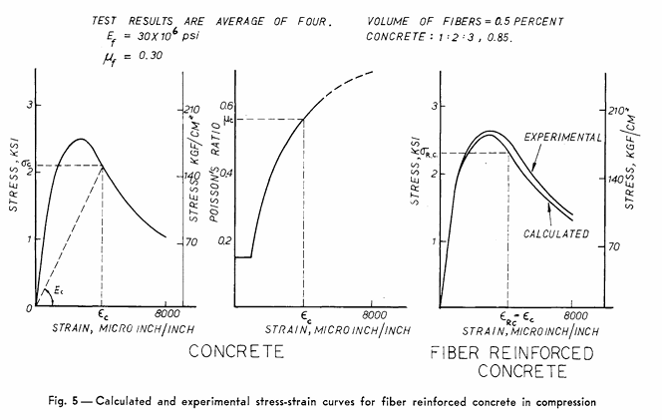
FRC AS A COMPOSITE MATERIAL & IMPORTANT RESULTS
FRC as a Composite Material:
The paper modeled SFRC as:
concrete matrix
steel fiber reinforcement
Significance of the Composite Approach:
  A critical SFRC behavior depends on interaction between:
    matrix cracking
    fiber bridging
    pullout resistance
  This became the basis for:
    constitutive modeling
    fracture mechanics approaches
    nonlinear FEM analysis
Overall Understanding:
The effectiveness of SFRC depends mainly on:
crack bridging
pullout resistance
energy absorption during crack propagation
Key Experimental Findings:
  1. Toughness increase >> strength increase
  2. Fibers mainly act after cracking
  3. Fiber orientation strongly affects performance
  4. High aspect ratio fibers improve crack bridging
  5. Fibers improve ductility in compression
  6. Spacing effect is limited below critical crack length
Fig 7. Calculated and experimental stress-strain curves for fiber reinforced concrete in compression

Slide 11
ADVANTAGES, LIMITATIONS, MODERN RELEVANCE & FINAL CONCLUSION
Advantages of SFRC:
improved toughness
better crack control
enhanced ductility
higher impact resistance
improved fatigue performance
improved post-cracking energy absorption
Limitations of SFRC:
random fiber orientation reduces efficiency
workability and mixing difficulties
higher material cost
fibers cannot fully replace conventional rebars
Modern Relevance of the Paper:
This paper became the theoretical foundation for:
Steel Fiber Reinforced Concrete (SFRC)
Engineered Cementitious Composites (ECC)
Ultra High Performance Concrete (UHPC)
HPFRCC materials
Modern Applications:
tunnel linings
pavements
industrial floors
seismic-resistant structures
blast-resistant concrete
Research Importance:
The paper shifted FRC research from:
  crack prevention
  to
  controlled crack propagation and toughness enhancement
This fundamentally changed the understanding of fiber action in concrete.
Final Conclusion:
The paper demonstrated that steel fibers primarily improve:
post-cracking toughness
crack propagation resistance
ductility
energy absorption
rather than significantly increasing crack initiation strength.
Historical Contribution:
The most important contribution of this paper was establishing crack propagation resistance as the dominant strengthening mechanism in SFRC.

